Slide 1
SOLUTIONS AND STANDARDS PREPARATION

Slide 2
How to weigh using Analytical Balance https://www.youtube.com/watch?v=mmgiehwrK54&t=65s
Use of Standard flask in preparing different volume of standard solutions https://www.youtube.com/watch?v=9xQxA5PHrA4

Slide 3
Preparing different concentrations of solutions from stock solution.
What is stock solution?
A stock solution is a concentrated solution which is used to prepare dilute solution of some lower concentration for actual use.
Stock solutions are prepared in standardized concentration which are commonly used in analytical Chemistry titrations.
Hydrochloric acid (HCl) and sodium hydroxide (NaOH) can be prepared as stock solutions.

Slide 4
A dilute solution is prepared by adding more solvent to a more concentrated solution (stock solution), which reduces the concentration of the solution.
For example,
98% Sulfuric acid is a concentrated solution of approximately 18M, which is commonly available in analytical labs. It is used to prepare sulfuric acid solutions for Various purposes like titration.

Slide 5
STANDARD SOLUTION
A standard solution is one that has a known concentration.
With a standard solution, it is possible to investigate the concentration of other solutions of unknown concentration by titration.

Slide 6
Stock/Standard Solution Preparation
A stock/standard solution can be prepared by weighing out accurate amount of a pure solid or by measuring out accurate volume of a pure liquid and diluting to a known concentration.

Slide 7
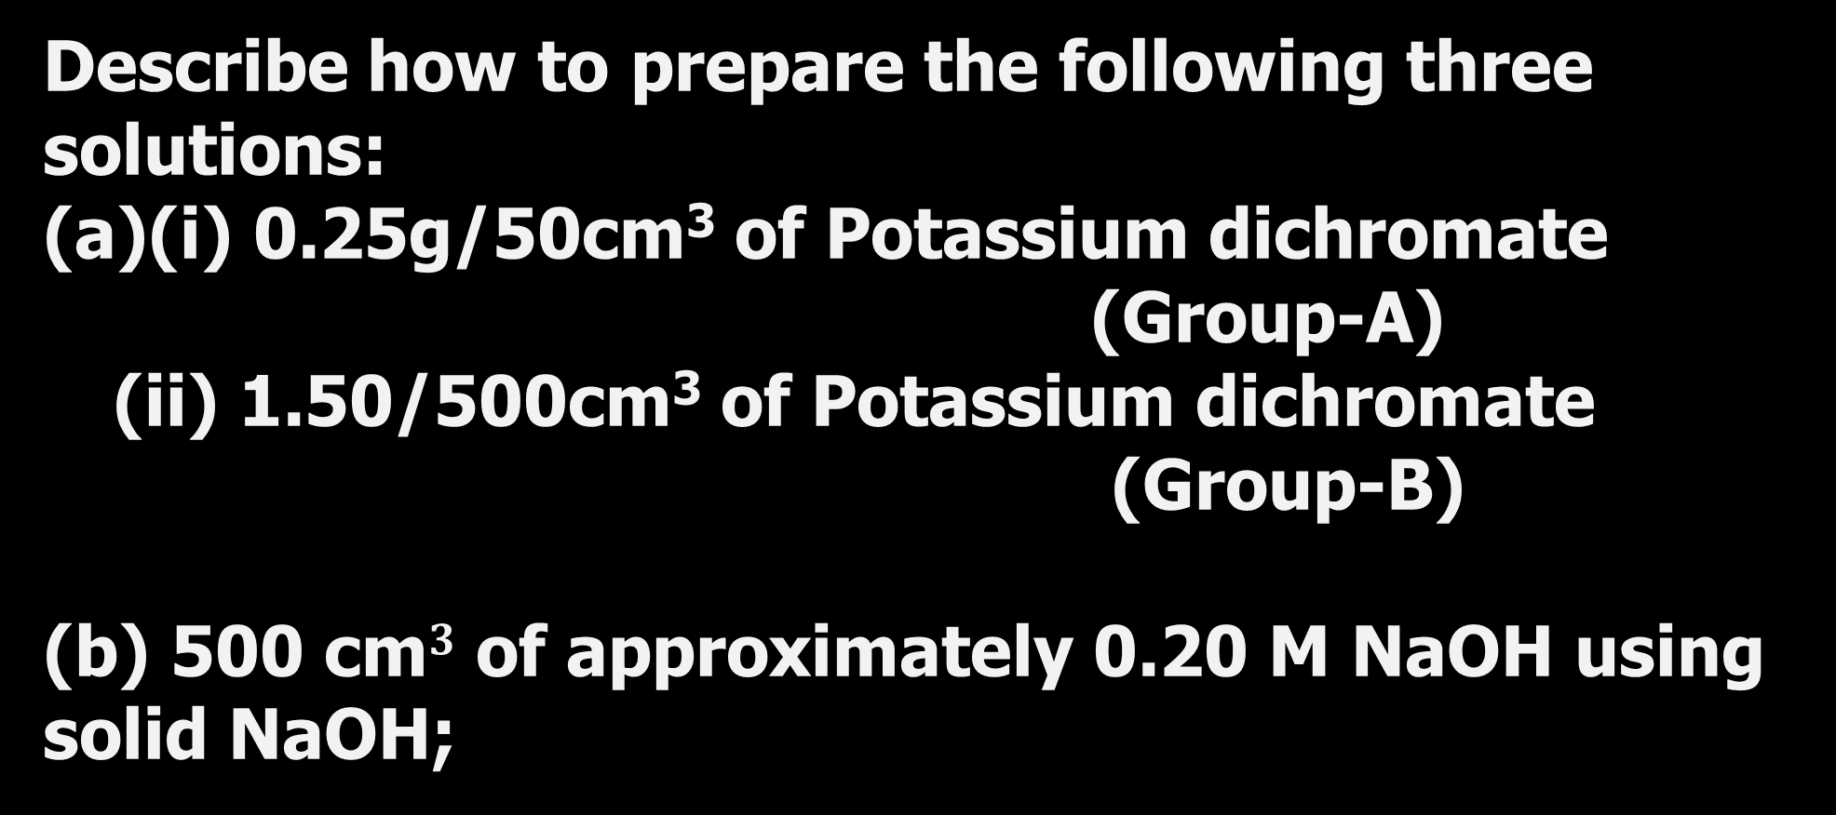
EXERCISE
Describe how to prepare the following three solutions:
(a)(i) 0.25g/50cm³ of Potassium dichromate
(Group-A)
(ii) 1.50/500cm³ of Potassium dichromate
(Group-B)
(b) 500 cm$3$ of approximately 0.20 M NaOH using solid NaOH;

Slide 8
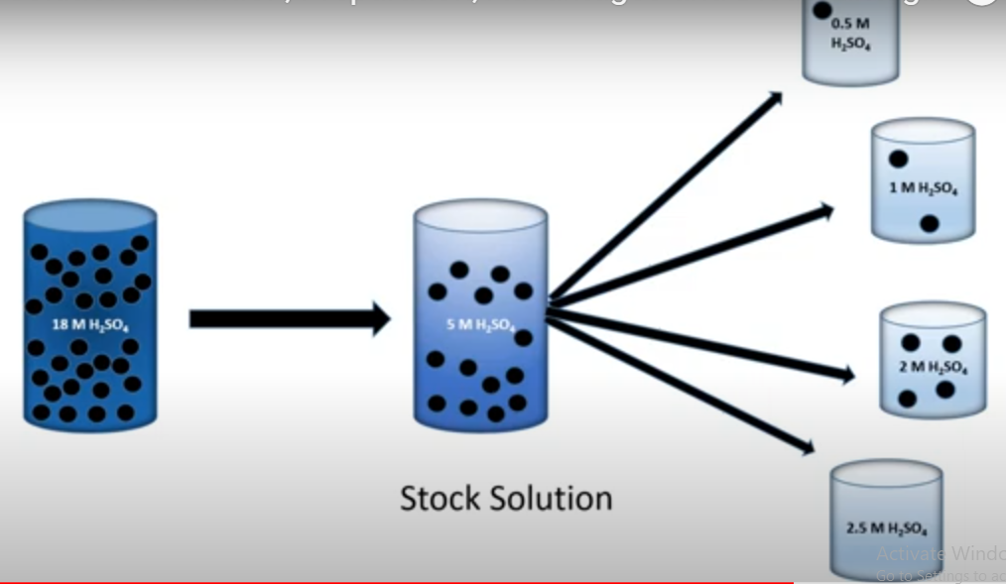

Slide 9
Question
How would you prepare 400cm³ of a 1.5M NaCl solution from a 5.0M stock?
Solution
Using, C_{s} × V_{s} = C_{d} × V_{d}

Slide 10
Calculations involving Concentration and its application.
1. Calculate the concentration of the stock solution prepared in the standard flask above
2. What is the concentration of a solution that contains 0.70 moles of NaCl in 400cm³.
3. How many grams of NaCl are required to make 250cm³ of a 0.50moldm⁻³ solution?

Slide 11
1. If you dilute 175 cm³ of a 1.6 M solution of LiCl to 1.0 dm³, determine the new concentration of the solution.
2. You need to make 10.0 dm³ of 1.2M KNO₃. What molarity would the potassium nitrate solution need to be if you were to use only 2.5 dm³ of it?
3. A laboratory procedure calls for 250 mL of an approximately 0.10 M solution of NH₃. Describe how you would prepare this solution using a stock solution of concentrated NH₃ (14.8 M).

Slide 12

and solving for gives 1.7 mL. Since we are making a solution that is approximately 0.10 M NH₃, we can use a graduated cylinder to measure the 1.7 mL of concentrated NH₃, transfer the NH₃ to a beaker, and add sufficient water to give a total volume of approximately 250 mL.

